Slide 1
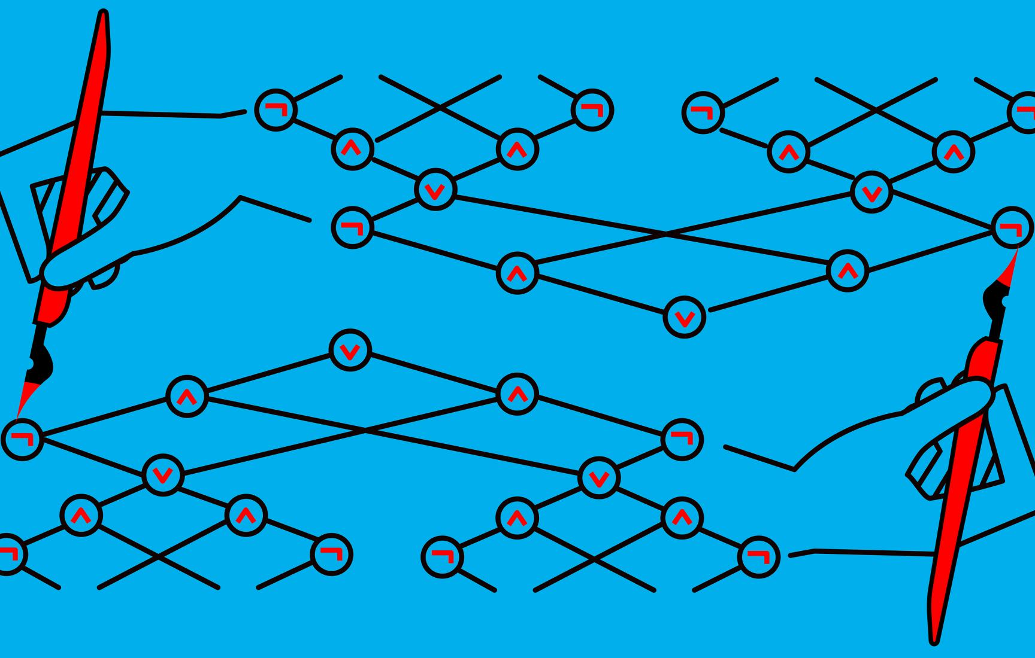
Meta-Complexity: The complexity of complexity

Slide 2

What is Meta-Complexity?

Slide 3
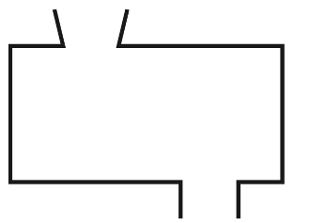


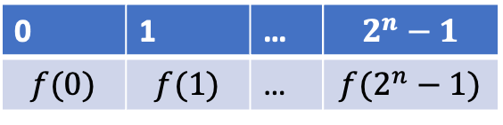
The Minimum Circuit Size Problem (MCSP)
$\text{INPUT}\text{:}$ $f: \{0,1\}^{n}→\{0,1\} , size s$
0 | 1 | … | $$2^{n}−1$$
$$f(0)$$ | $$f(1)$$ | … | $$f(2^{n}−1)$$
$$1^{s}$$
$$A$$
$\text{OUTPUT}\text{:}$ (decision ver.) Is there a size-$s$ circuit computing $f?$
(search ver.) Also find the size-$s$ circuit.

Slide 4
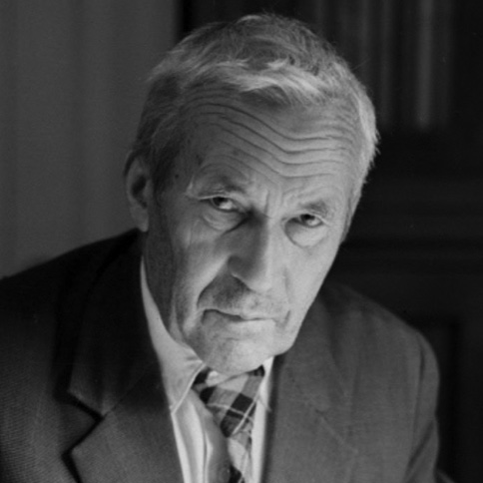
Kolmogorov Complexity
A definition of information
A = 01010101010101010101010101
B = 11001011010001110101000011
Which one contains more information?
Andrey N. Kolmogorov

Slide 5
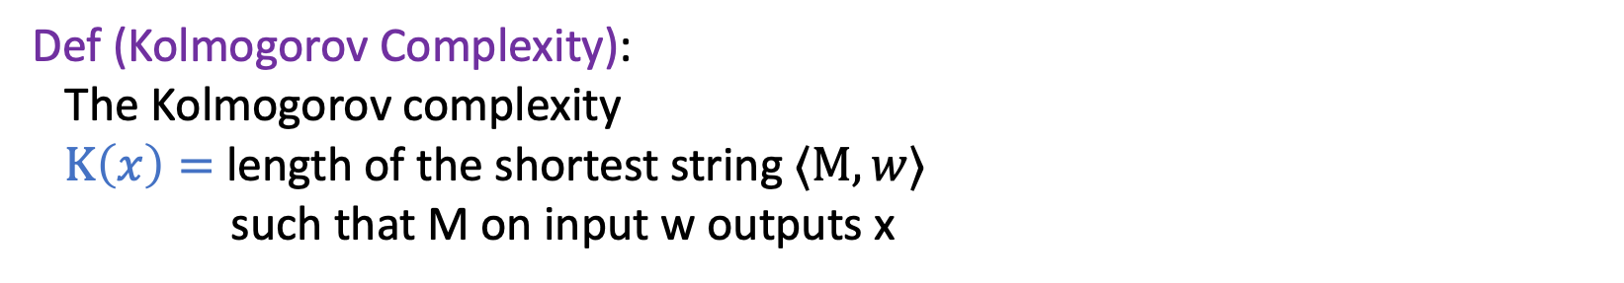

Kolmogorov Complexity
Def (Kolmogorov Complexity):
The Kolmogorov complexity
$K\left(x\right)=$length of the shortest string $⟨M,w⟩$
such that M on input w outputs x
Remark:
Why separate input & program?
People want $K\left(x\right)≤\left|x\right|+O\left(1\right)$ not just $K\left(x\right)≤O\left(\left|x\right|\right).$
Andrey N. Kolmogorov
Minimum Kolmogorov Complexity Problem:
Undecidable!
``The first English sentence that needs fourteen words to describe.’’

Slide 6
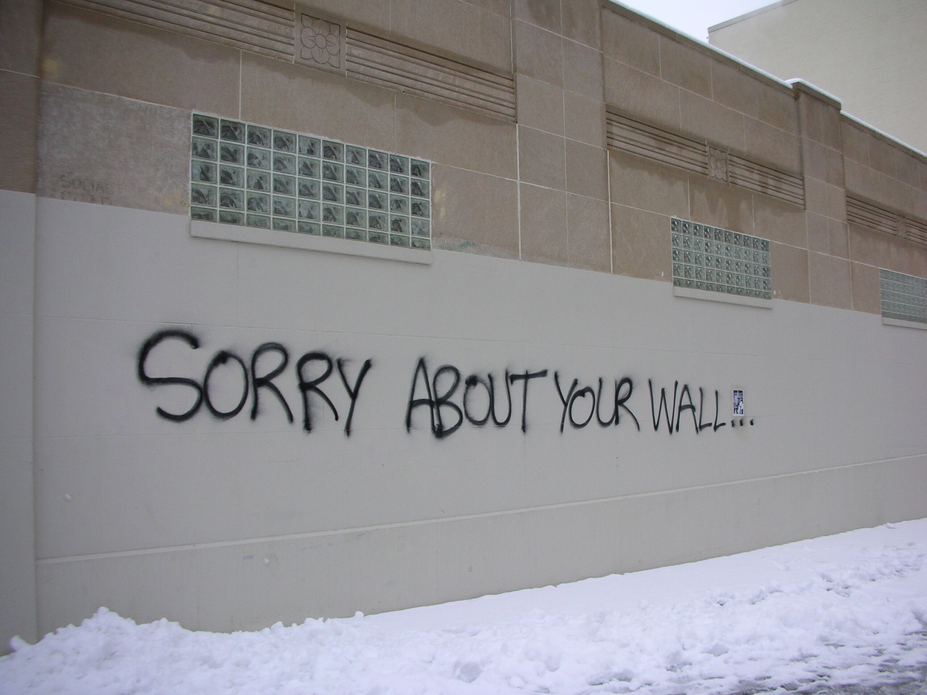
Self-reference

Slide 7
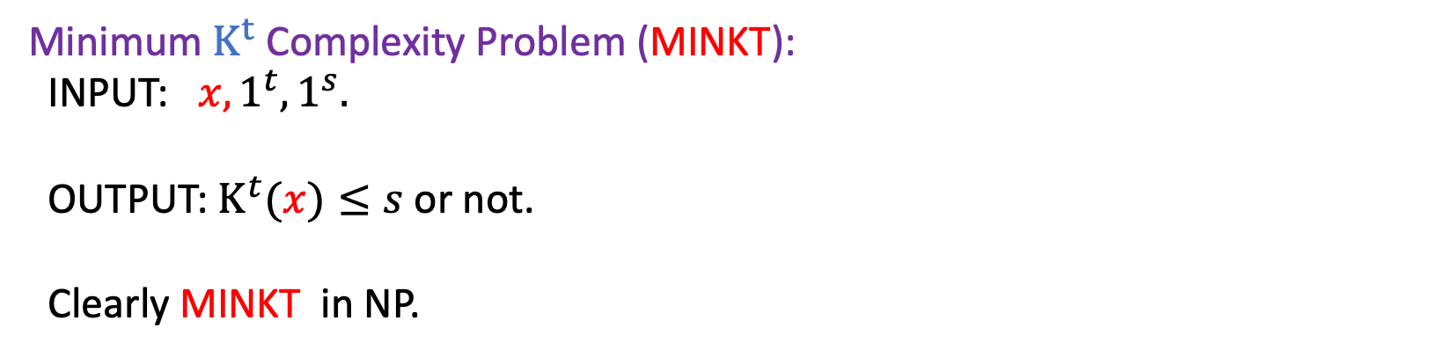
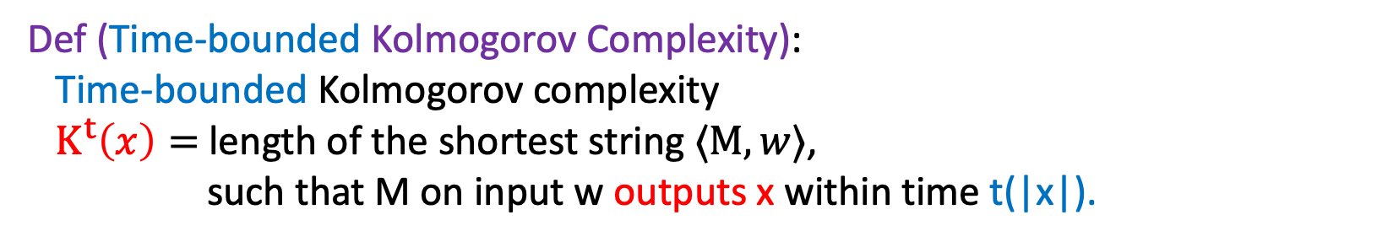
Time-bounded Kolmogorov Complexity
Def (Time-bounded Kolmogorov Complexity):
Time-bounded Kolmogorov complexity
$K^{t}\left(x\right)=$length of the shortest string $⟨M,w⟩$,
such that M on input w outputs x within time t(|x|).
Minimum $K^{t}$ Complexity Problem (MINKT):
INPUT: $x,1^{t}, 1^{s}.$
OUTPUT: $K^{t}(x)≤s$ or not.
Clearly MINKT in NP.

Slide 8
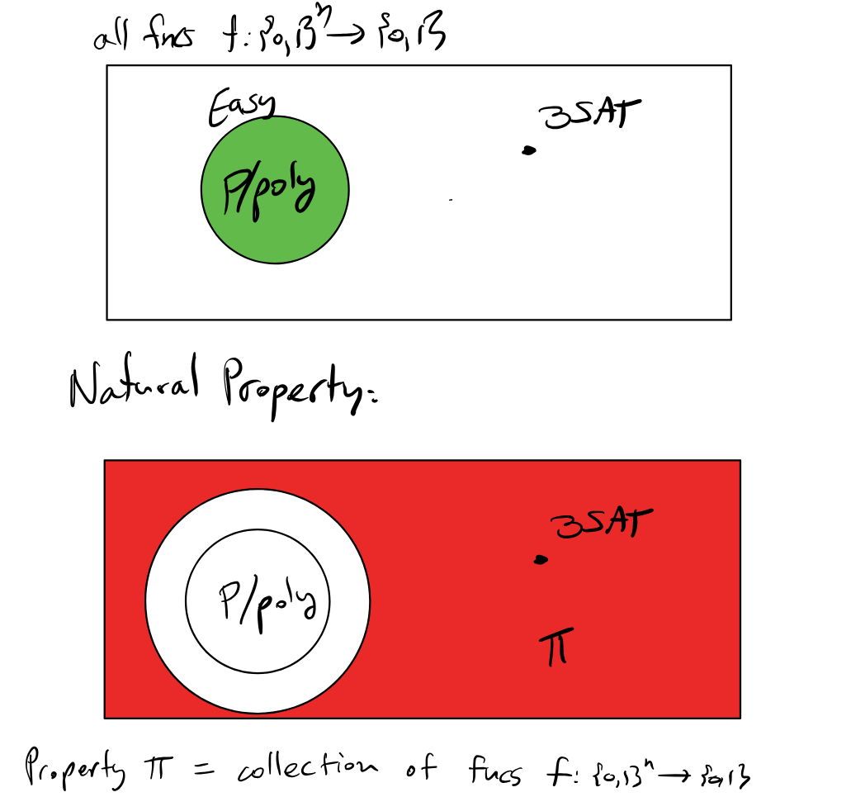
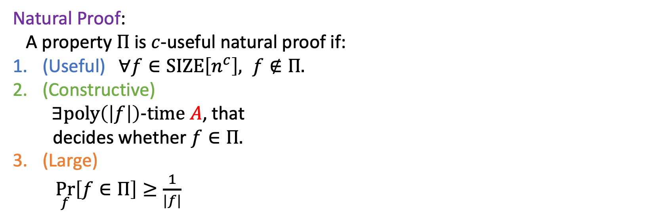
Recap: Natural Proof
Motivating Question:
Why are circuit lower bounds so hard?
Natural Proof:
A property $Π$ is $c$-useful natural proof if:
(Useful) $∀f∈SIZE\left[n^{c}\right], f∉Π.$
(Constructive)
$∃poly\left(\left|f\right|\right)−time A$, that
decides whether $f∈Π.$
(Large)
$\underset{f}{Pr}\left[f∈Π\right]≥\frac{1}{|f|}$

Slide 9
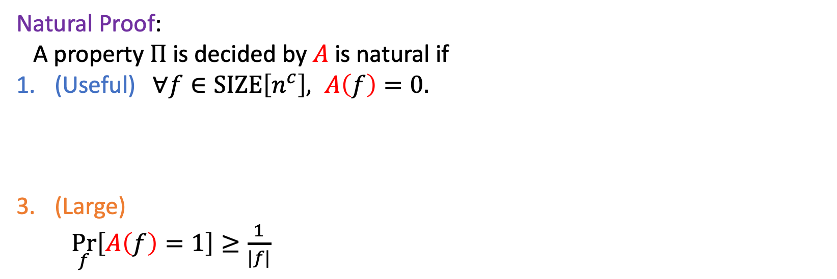
Recap: Natural Proof
Motivating Question:
Why are circuit lower bounds so hard?
Natural Proof:
A property $Π$ is decided by $A$ is natural if
(Useful) $∀f∈SIZE\left[n^{c}\right], A\left(f\right)=0.$
(Large)
$\underset{f}{Pr}\left[A\left(f\right)=1\right]≥\frac{1}{|f|}$

Slide 10
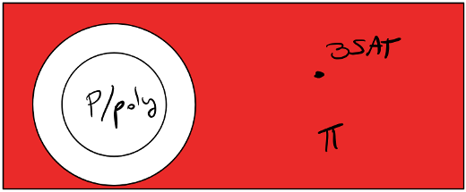



Natural Proof vs. MCSP
MCSP
$\text{INPUT}\text{:}$ $f: \{0,1\}^{n}→\{0,1\} , size s$
$\text{OUTPUT}\text{:}$ (decision ver.) Is there a size-$s$ circuit computing $f?$
Natural Proof
$\text{INPUT}\text{:}$ $f: \{0,1\}^{n}→\{0,1\} , size n^{c}$
$\text{OUTPUT}\text{:}$ Is there a size-$n^{c}$ circuit computing $f?$
(Only correct ``on average”).

Slide 11
What is Meta-Complexity?
E.g.
- MCSP
- MINKT
- Natural Proofs
Meta complexity problems.
They are all in NP. Are they in P?

Slide 12
Why do we care about Meta-Complexity?

Slide 13


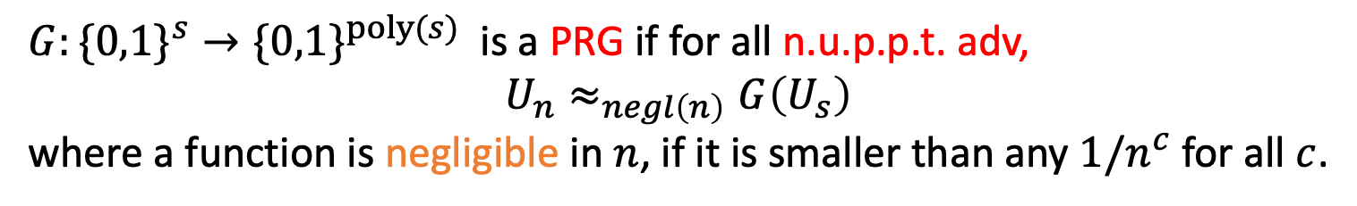
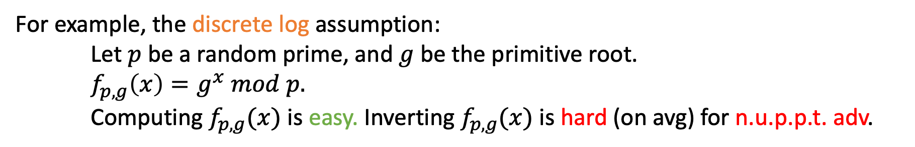



Cryptography 101
Public $p,g$
OWF (One-way Function)
User $x$
Adv $f(x)$
For example, the discrete log assumption:
Let $p$ be a random prime, and $g$ be the primitive root.
$f_{p,g}\left(x\right)=g^{x} mod p.$
Computing $f_{p,g}(x)$ is easy. Inverting $f_{p,g}(x)$ is hard (on avg) for n.u.p.p.t. adv.
PRG (Pseudorandom generator)
$G:\{0,1\}^{s}→\{0,1\}^{poly(s)}$ is a PRG if for all n.u.p.p.t. adv,
$$U_{n}≈_{negl\left(n\right)}G\left(U_{s}\right)$$
where a function is negligible in $n$, if it is smaller than any $1/n^{c}$ for all $c$.
OWF => PRG => PRF / Commitment / Symmetric Encryption……
“secret key crypto”

Slide 14
Complexity PRG vs. Crypto PRG
Complexity PRG (e.g. NW PRG). Crypto PRG
Indistinguishable for. Fixed poly adv. Any poly adv.
(usually less than running time of the PRG)
Seed length. log(n) poly(n)
Running time exponential in seed length polynomial in seed length

Slide 15
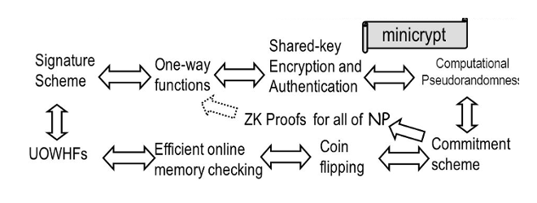
Secret-key crypto

Slide 16

If MCSP $∈P$ …
[Kabanets & Cai 99] [Razborov & Rudich 97]
If MCSP is in P, there is no pseudorandom generators, thus no crypto.
or
Assume there is crypto, there is no natural proof. (MCSP is hard on average.)
Key observation:
MCSP breaks PRGs!

Slide 17
Why do we care about Meta-Complexity?
MCSP breaks PRGs!
Connection to Average Case Complexity Theory
It might solve the Crypto holy-grail!
Mysteries around its NP-hardness.

Slide 18
Motivations for average case complexity
Cryptography
For example, crypto schemes usually looks like this:
1. Generate random key k.
2. Encrypt message m and get y = f(k, m).
3. If the adversary can break the scheme, it can solve a hard problem on instance y.
For this scheme to be secure, the problem has to be average-case hard.
Some algorithms (heuristics) work well on average.
1. Smoothed analysis [Spielman & Teng’01] of simplex method
2. SAT solvers

Slide 19
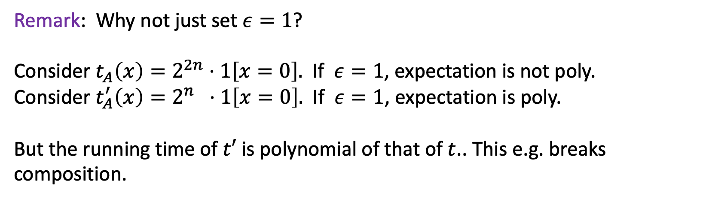
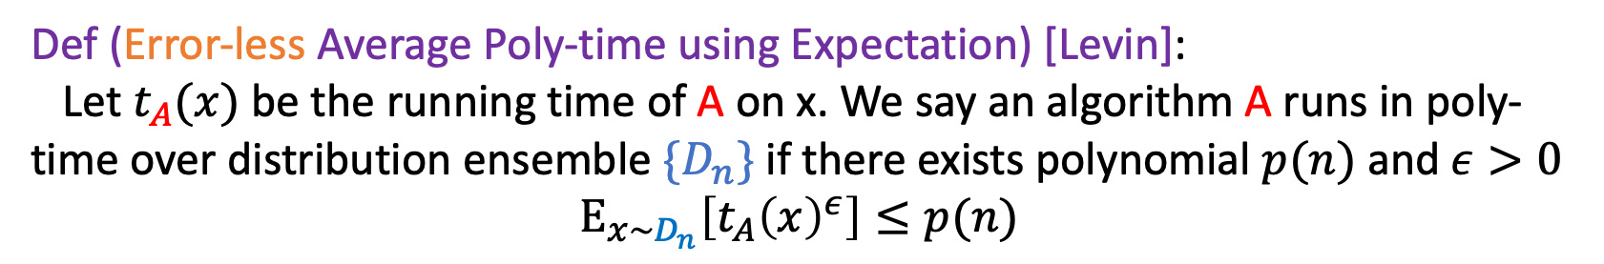
Average Case Complexity
Def (Error-less Average Poly-time using Expectation) [Levin]:
Let $t_{A}(x)$be the running time of A on x. We say an algorithm A runs in poly-time over distribution ensemble ${\{D}_{n}\}$ if there exists polynomial $p(n)$and $ε>0$
$E_{x∼D_{n}}\left[t_{A}{\left(x\right)}^{ε}\right]≤p(n)$
Remark: Why not just set $ε=1$?
Consider $t_{A}\left(x\right)=2^{2n}⋅1\left[x=0\right].$ If $ε=1$, expectation is not poly.
Consider $t_{A}^{′}\left(x\right)=2^{n} ⋅1\left[x=0\right].$ If $ε=1$, expectation is poly.
But the running time of $t′$ is polynomial of that of $t$.. This e.g. breaks composition.

Slide 20
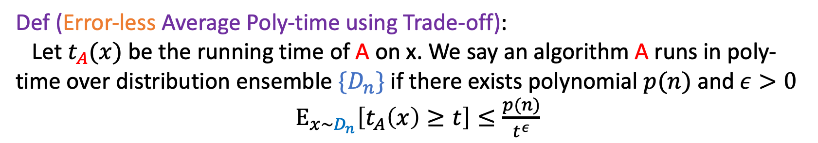

Average Case Complexity
Def (Error-less Average Poly-time using Trade-off):
Let $t_{A}(x)$be the running time of A on x. We say an algorithm A runs in poly-time over distribution ensemble ${\{D}_{n}\}$ if there exists polynomial $p(n)$and $ε>0$
$E_{x∼D_{n}}\left[t_{A}\left(x\right)≥t\right]≤\frac{p(n)}{t^{ε}}$
Remark: Here we have $ε$ for the same reason. In fact, they are equivalent.
Biggest Open Question in Avg-case Complexity: Is NP easy on average?
$$distNP=AvgP?$$

Slide 21
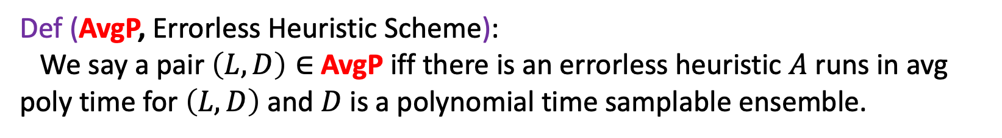
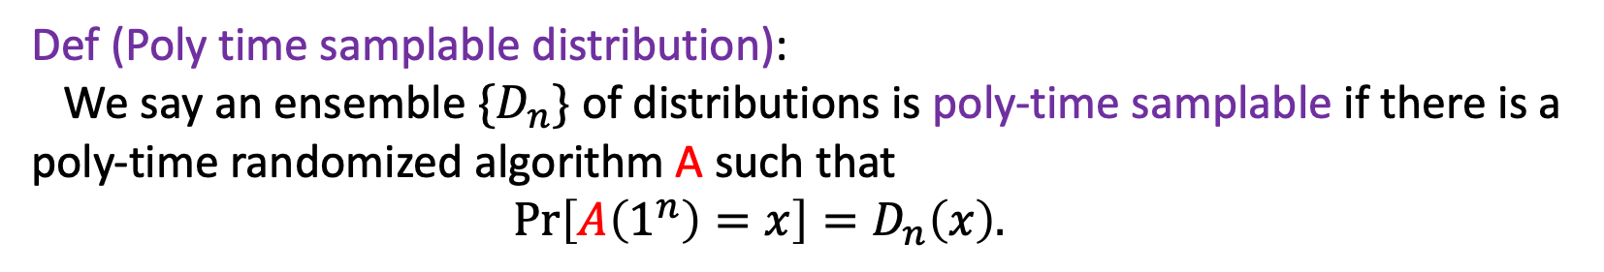

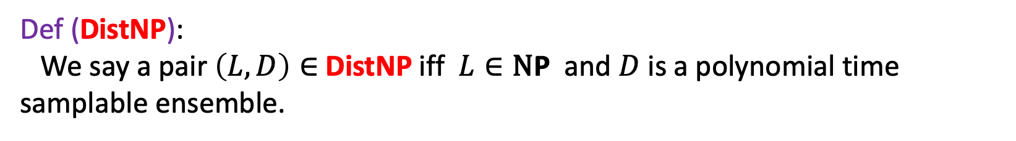
Average Case Complexity
Is NP easy on average?
$$distNP=AvgP?$$
Def (Poly time samplable distribution):
We say an ensemble $\{D_{n}\}$ of distributions is poly-time samplable if there is a poly-time randomized algorithm A such that
$Pr\left[A\left(1^{n}\right)=x\right]=D_{n}\left(x\right).$
Def (AvgP, Errorless Heuristic Scheme):
We say a pair $\left(L, D\right)∈$ AvgP iff there is an errorless heuristic $A$ runs in avg poly time for $\left(L, D\right)$ and $D$ is a polynomial time samplable ensemble.
Def (DistNP):
We say a pair $\left(L, D\right)∈$ DistNP iff $L∈\text{N}\text{P}$ and $D$ is a polynomial time samplable ensemble.

Slide 22
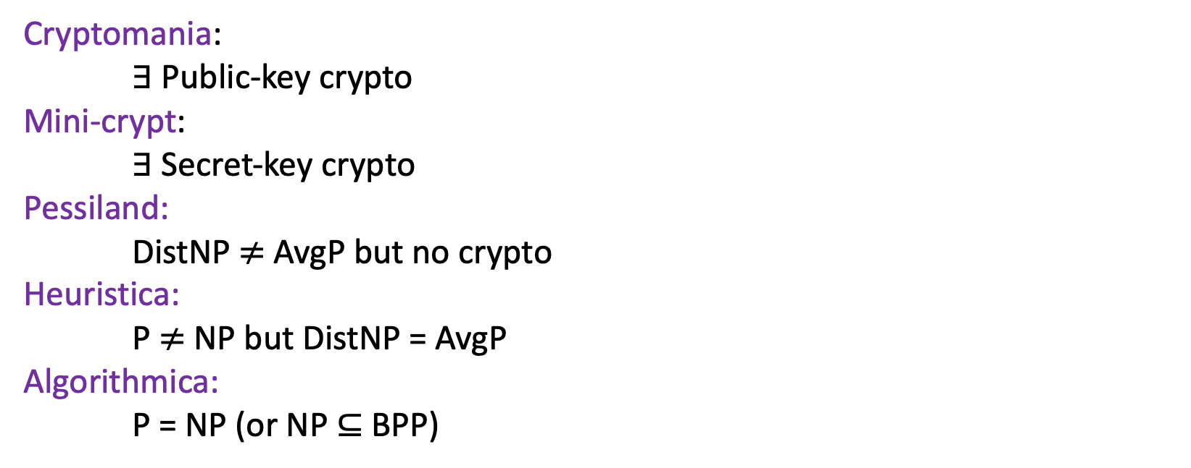
Impagliazzo’s Five Worlds
Cryptomania:
$∃$ Public-key crypto
Mini-crypt:
$∃$ Secret-key crypto
Pessiland:
DistNP $≠$ AvgP but no crypto
Heuristica:
P $≠$ NP but DistNP = AvgP
Algorithmica:
P = NP (or NP $⊆$ BPP)
Excluding Heuristica
“worst-case to average-case reduction”
[FF’ 93] You can’t do it with “nonadaptive black-box” reductions. (Barrier)
[Hirahara’ 18] You can do it with meta-complexity techniques! (Breakthrough)

Slide 23
Why do we care about Meta-Complexity?
MCSP breaks PRGs!
Connection to Average Case Complexity Theory
It might solve the Crypto holy-grail!
Mysteries around its NP-hardness.

Slide 24
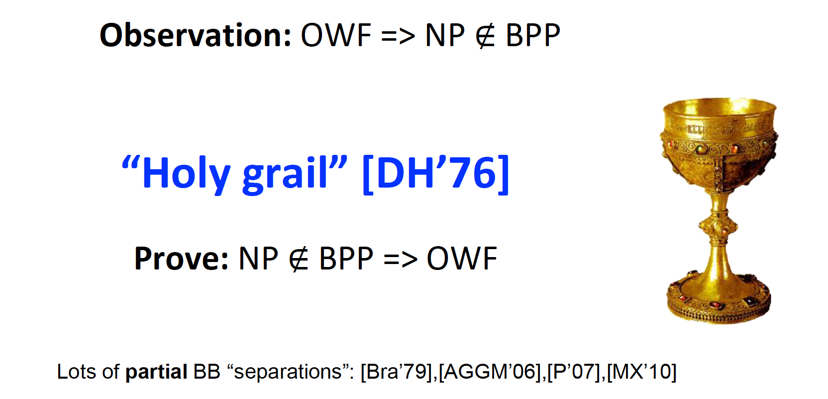
The holy-grail of crypto

Slide 25
The holy-grail of crypto
Cryptomania:
$∃$ Public-key crypto
Mini-crypt:
$∃$ Secret-key crypto
Pessiland:
DistNP $≠$ AvgP but no crypto
Heuristica:
P $≠$ NP but DistNP = AvgP
Algorithmica:
P = NP (or NP $⊆$ BPP)
Excluding Heuristica & Pessiland!

Slide 26
We will see…
So… Problem solved?
Cryptomania:
$∃$ Public-key crypto
Mini-crypt:
$∃$ Secret-key crypto
Pessiland:
DistNP $≠$ AvgP but no crypto
Heuristica:
P $≠$ NP but DistNP = AvgP
Algorithmica:
P = NP (or NP $⊆$ BPP)
[Liu-Pass’ 20]
Avg-Case Hardness of Meta Complexity Problem
[Hirahara’ 18]
If NP-hard
Worst-Case Hardness of Meta Complexity Problem
[Hirahara’ 22]

Slide 27
We will see…
So… Problem solved?
Gaps are everywhere!
Cryptomania:
$∃$ Public-key crypto
Mini-crypt:
$∃$ Secret-key crypto
Pessiland:
DistNP $≠$ AvgP but no crypto
Heuristica:
P $≠$ NP but DistNP = AvgP
Algorithmica:
P = NP (or NP $⊆$ BPP)
[Liu-Pass’ 20]
Two-sided Avg-Case Hardness
Different distributions
Errorless Avg-Case Hardness
[Hirahara’ 18]
If NP-hard
MCSP*
Worst case hardness of approximate MINKT
[Hirahara’ 22]
Different problems

Slide 28
Why do we care about Meta-Complexity?
MCSP breaks PRGs!
Connection to Average Case Complexity Theory
It might solve the Crypto holy-grail!
Mysteries around its NP-hardness.

Slide 29
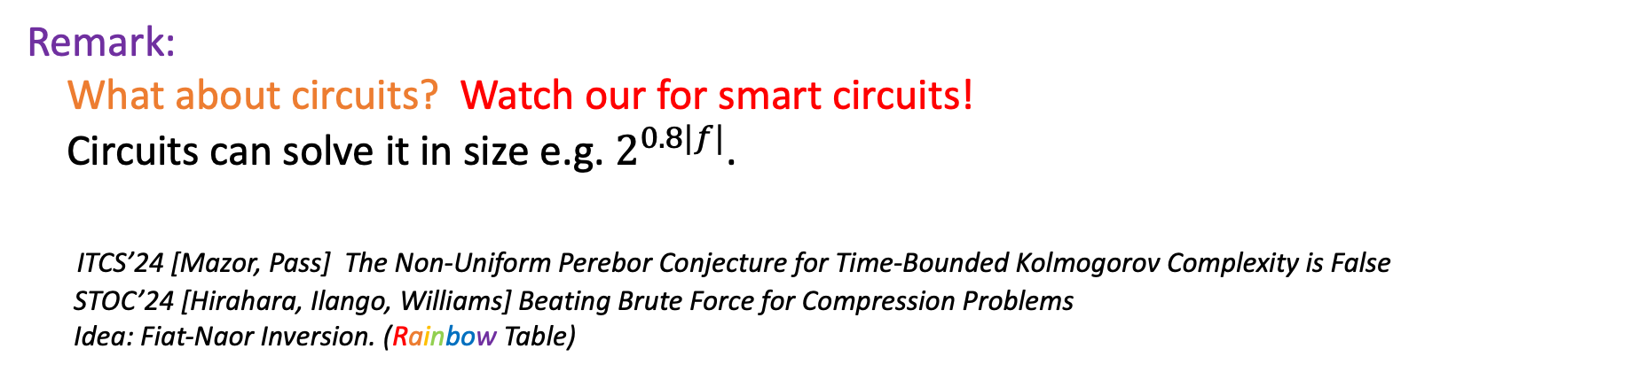
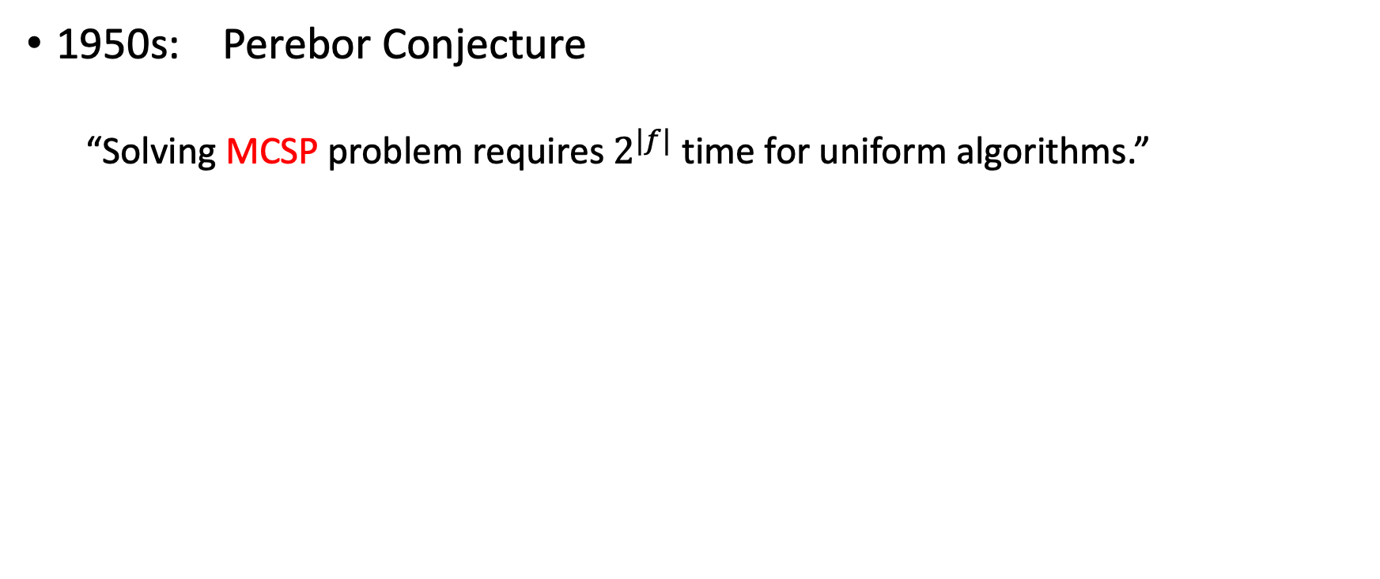
Mystery: NP-hardness of MCSP ?
1950s: Perebor Conjecture
“Solving MCSP problem requires $2^{|f|}$ time for uniform algorithms.”
Perebor: Russian for ”Brute-force search”
Remark:
What about circuits? Watch our for smart circuits!
Circuits can solve it in size e.g. $2^{0.8|f|}$.
ITCS’24 [Mazor, Pass] The Non-Uniform Perebor Conjecture for Time-Bounded Kolmogorov Complexity is False
STOC’24 [Hirahara, Ilango, Williams] Beating Brute Force for Compression Problems
Idea: Fiat-Naor Inversion. (Rainbow Table)

Slide 30
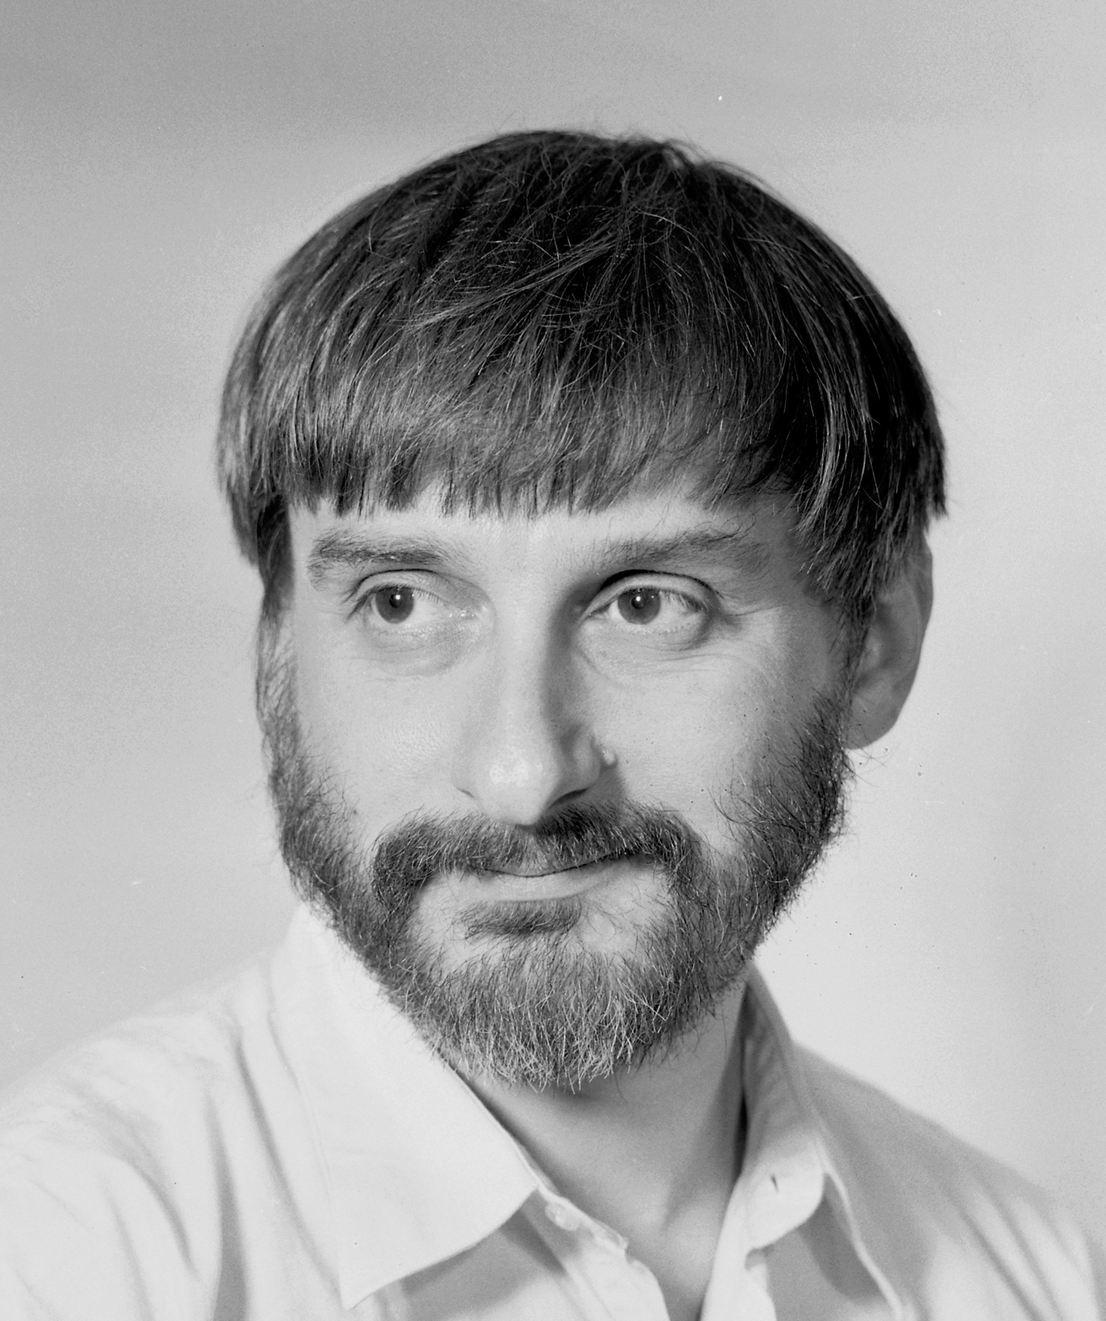
Mystery: NP-hardness of MCSP ?
1973: Levin
“I thought only extending [the theory of NP-completeness] to some popular problems, like graph isomorphism , circuits minimization, or (with less hope) factoring, would be worth publishing. I tried for a long time”
L. Levin
Today we know factoring, graph isomorphism are unlikely to be NP-hard (unless PH collapses)…..

Slide 31


Mystery: NP-hardness of MCSP ?
Why is it so hard?
An intuitive explanation against deterministic reductions:
Reduction R
SAT
MCSP
$$x_{1}∧ ¬x_{1}$$
$$\text{R}(x_{1}∧ ¬x_{1})$$
As R is efficient,
this should be low-complexity
As it is a NO instance, it should be
high-complexity
For randomized-reduction:
Oracle-independence Barrier [Hirahara & Watanabe’ 15]

Slide 32
Why do we care about Meta-Complexity?
MCSP breaks PRGs!
Connection to Average Case Complexity Theory
It might solve the Crypto holy-grail!
Mysteries around its NP-hardness.

Slide 33
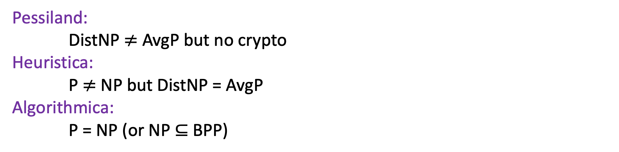
How does Meta-Complexity help?
Pessiland:
DistNP $≠$ AvgP but no crypto
Heuristica:
P $≠$ NP but DistNP = AvgP
Algorithmica:
P = NP (or NP $⊆$ BPP)
Excluding Heuristica
“worst-case to average-case reduction”
[FF’ 93] You can’t do it with “nonadaptive black-box” reductions. (Barrier)
[Hirahara’ 18] You can do it with meta-complexity techniques! (Breakthrough)

Slide 34
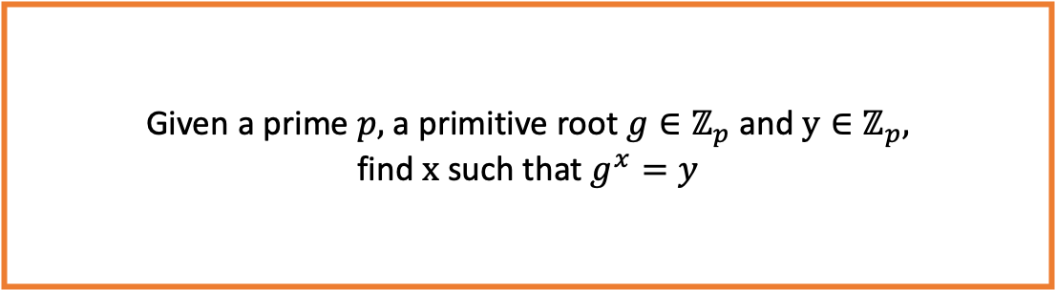
A simple example
Worst-case to average-case reduction for discrete log
Given a prime $p,$a primitive root $g∈ℤ_{p}$ and $y∈ℤ_{p},$
find $x$ such that $g^{x}=y$
Discrete log problem

Slide 35
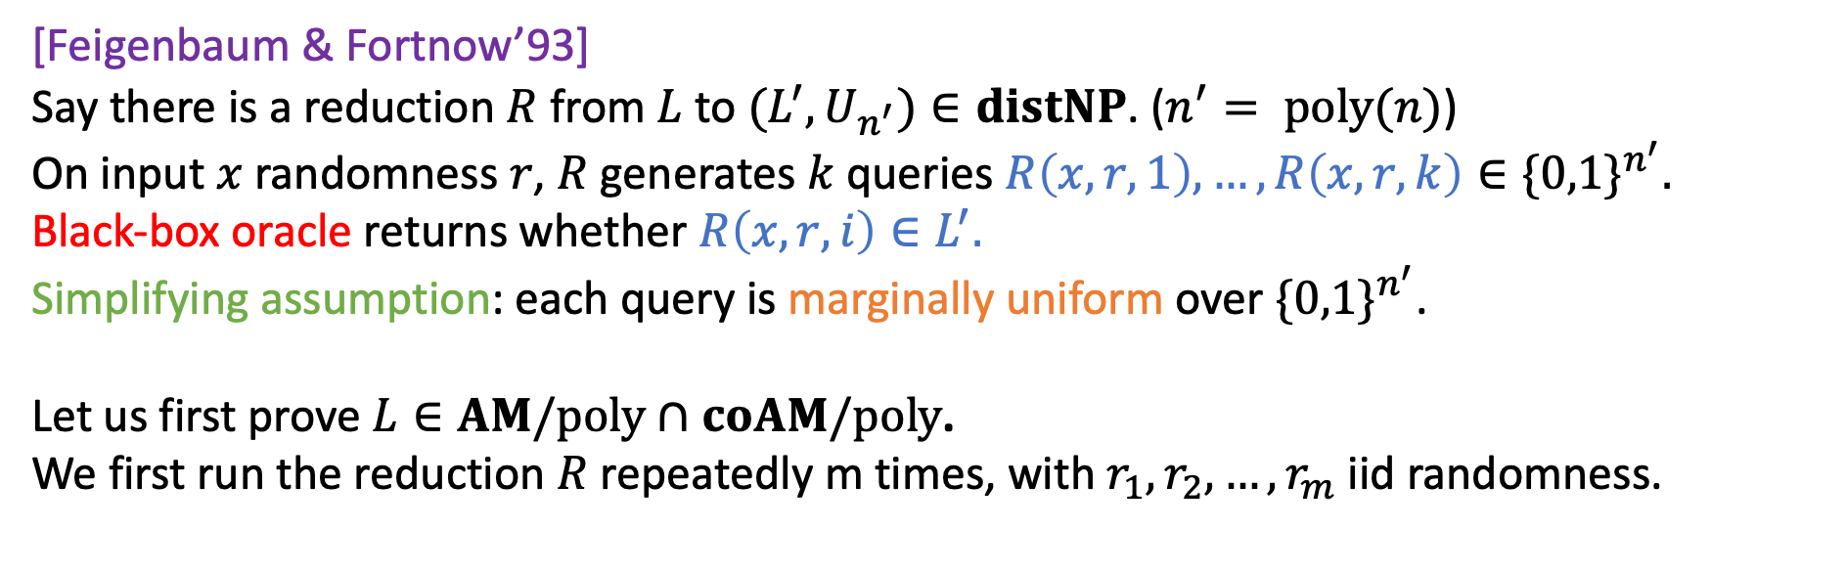
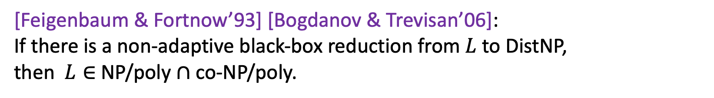
[FF’93] Barrier for worst-case to avg-case
[Feigenbaum & Fortnow’93] [Bogdanov & Trevisan’06]:
If there is a non-adaptive black-box reduction from $L$ to DistNP,
then $L∈$NP/poly $∩$ co-NP/poly.
[Feigenbaum & Fortnow’93]
Say there is a reduction $R$ from $L$ to $(L^{′}, U_{n^{′}})∈distNP$. ($n^{′}= poly(n)$)
On input $x$ randomness $r$, $R$ generates $k$ queries $R\left(x,r,1\right), …, R\left(x,r,k\right)∈\{0,1\}^{n^{′}}.$
Black-box oracle returns whether $R\left(x,r,i\right)∈L^{′}.$
Simplifying assumption: each query is marginally uniform over $\{0,1\}^{n^{′}}$.
Let us first prove $L∈AM/poly∩coAM/poly$.
We first run the reduction $R$ repeatedly m times, with $r_{1}, r_{2},…, r_{m}$ iid randomness.

Slide 36
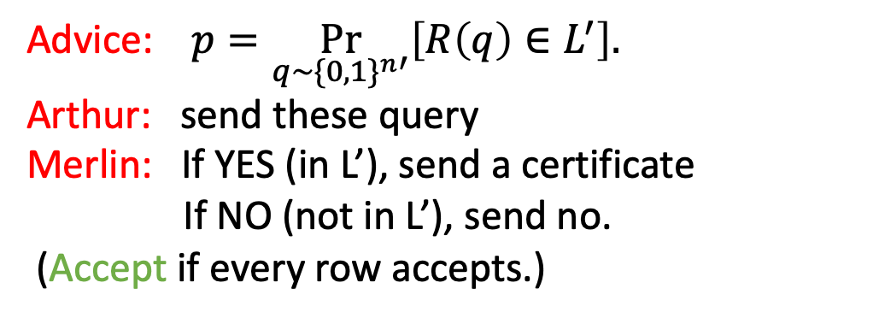
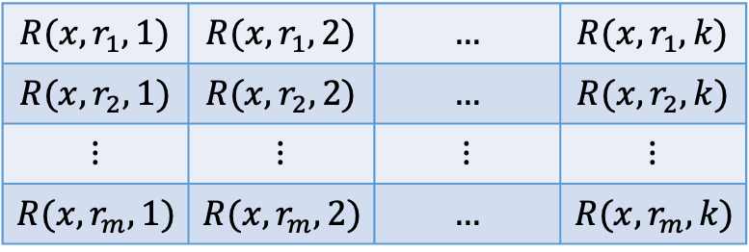

[FF’93] Barrier for worst-case to avg-case
[Feigenbaum & Fortnow’93] [Bogdanov & Trevisan’06]:
If there is a non-adaptive black-box reduction from $L$ to DistNP,
then $L∈$NP/poly $∩$ co-NP/poly.
Proof Sketch.
Advice: $p=\underset{q∼\{0,1\}^{n′}}{Pr}\left[R\left(q\right)∈L^{′}\right].$
Arthur: send these query
Merlin: If YES (in L’), send a certificate
If NO (not in L’), send no.
(Accept if every row accepts.)
$$R(x,r_{1},1)$$ | $$R(x,r_{1},2)$$ | $$…$$ | $$R(x,r_{1},k)$$
$$R(x,r_{2},1)$$ | $$R(x,r_{2},2)$$ | $$…$$ | $$R(x,r_{2},k)$$
$$⋮$$ | $$⋮$$ | $$⋮$$ | $$⋮$$
$$R(x,r_{m},1)$$ | $$R(x,r_{m},2)$$ | $$…$$ | $$R(x,r_{m},k)$$

Slide 37
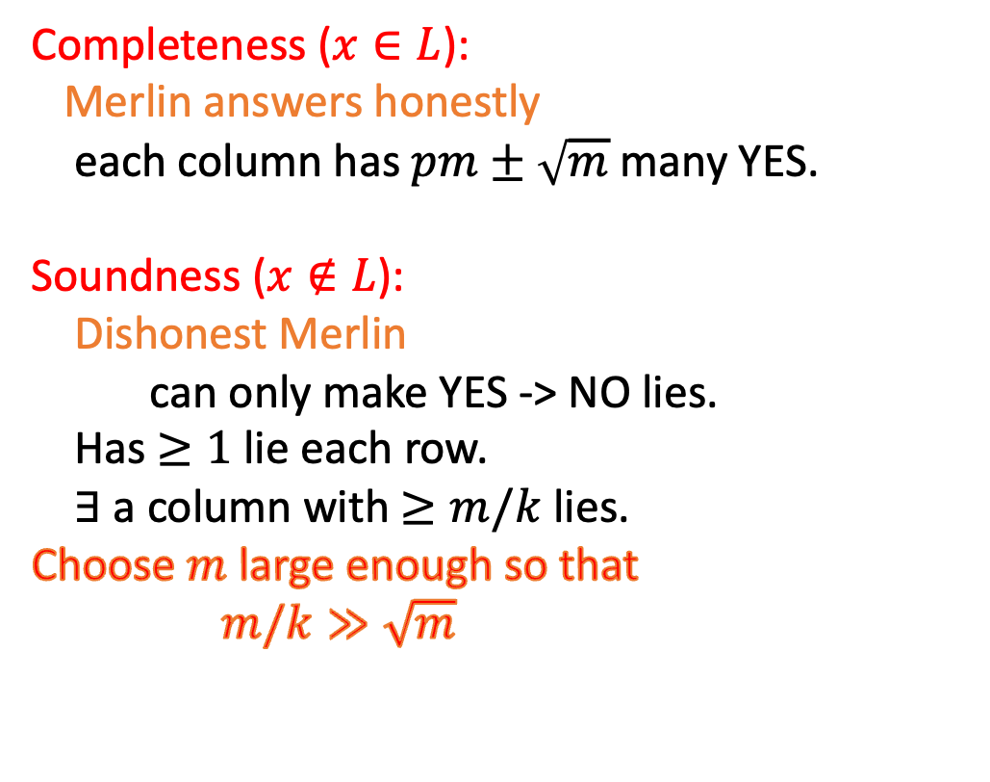
[FF’93] Barrier for worst-case to avg-case
[Feigenbaum & Fortnow’93] [Bogdanov & Trevisan’06]:
If there is a non-adaptive black-box reduction from $L$ to DistNP,
then $L∈$NP/poly $∩$ co-NP/poly.
Completeness ($x∈L$):
Merlin answers honestly
each column has $pm±\sqrt{m}$ many YES.
Soundness ($x∉L$):
Dishonest Merlin
can only make YES -> NO lies.
Has $≥1$ lie each row.
$∃$ a column with $≥m/k$ lies.
Choose $m$ large enough so that
$m/k≫\sqrt{m}$
Proof Sketch.
$$R(x,r_{1},1)$$ | $$R(x,r_{1},2)$$ | $$…$$ | $$R(x,r_{1},k)$$
$$R(x,r_{2},1)$$ | $$R(x,r_{2},2)$$ | $$…$$ | $$R(x,r_{2},k)$$
$$⋮$$ | $$⋮$$ | $$⋮$$ | $$⋮$$
$$R(x,r_{m},1)$$ | $$R(x,r_{m},2)$$ | $$…$$ | $$R(x,r_{m},k)$$

Slide 38
How does Meta-Complexity help?
Pessiland:
DistNP $≠$ AvgP but no crypto
Heuristica:
P $≠$ NP but DistNP = AvgP
Algorithmica:
P = NP (or NP $⊆$ BPP)
Excluding Heuristica
“worst-case to average-case reduction”
[FF’ 93] You can’t do it with “nonadaptive black-box” reductions. (Barrier)
[Hirahara’ 18] You can do it with meta-complexity techniques! (Breakthrough)

Slide 39
Complexity PRG vs. Crypto PRG
Complexity PRG (e.g. NW PRG). Crypto PRG
Indistinguishable for. Fixed poly adv. Any poly adv.
(usually less than running time of the PRG)
Seed length. log(n) poly(n)
Running time exponential in seed length polynomial in seed length

Slide 40
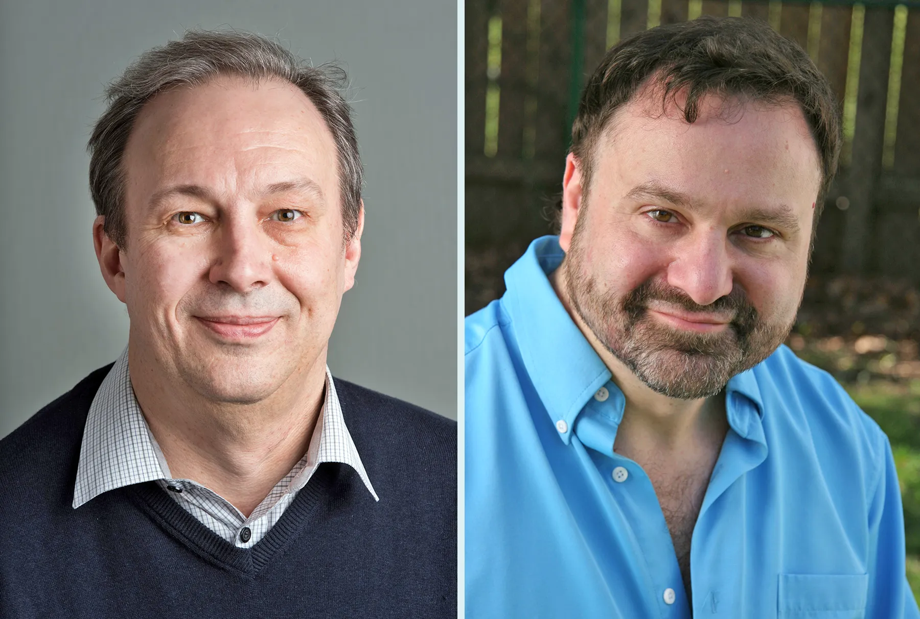
Recap: Natural Proof
Main Idea:
1. Suppose that there is a (sub-exponentially secure)
Pseudorandom function family (PRF).
Can be build from Crypto PRGs
2. Average-case algorithms (with one-sided error)
for MCSP (aka Natural proofs) break PRFs.
3. There is no natural proof.
What if we replace crypto PRG here with NW (complexity PRG)?
Alexander Razborov Steven Rudich

Slide 41

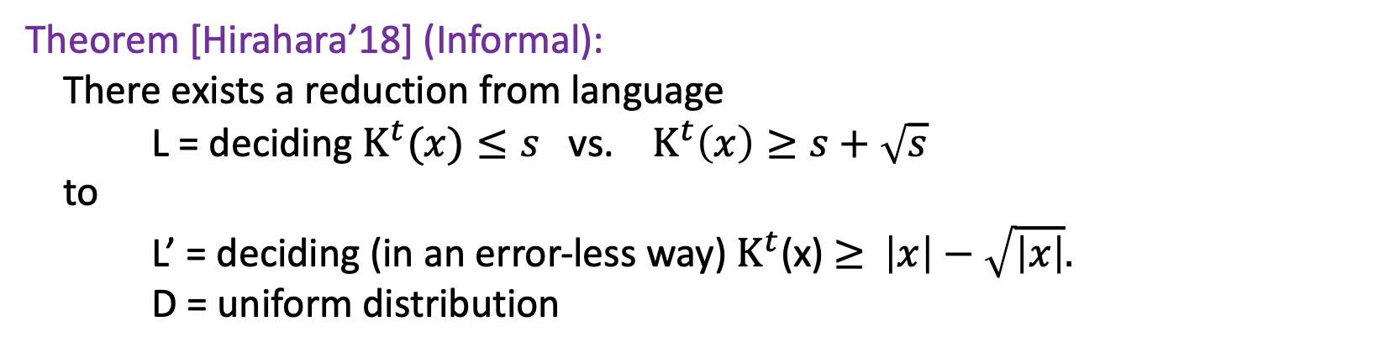
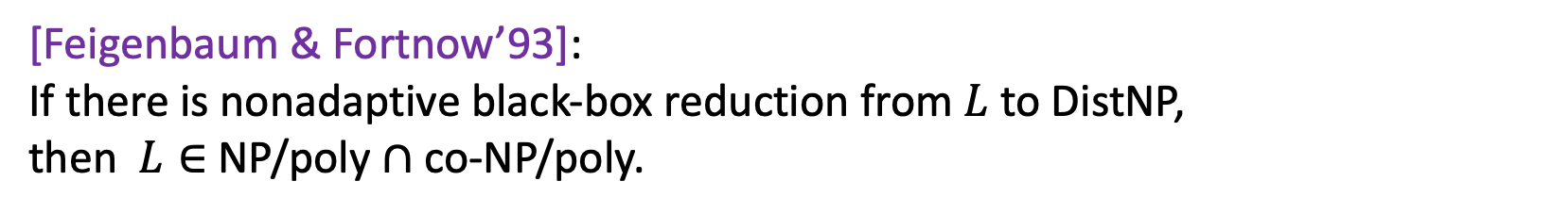
[Hirahara’18]
“Non-black-box Worst-case to Average-case Reductions within NP”
Theorem [Hirahara’18] (Informal):
There exists a reduction from language
L = deciding $K^{t}(x)≤s$ vs. $K^{t}\left(x\right)≥s+\sqrt{s}$
to
L’ = deciding (in an error-less way) $K^{t}$(x) $≥$ $\left|x\right|−\sqrt{\left|x\right|}.$
D = uniform distribution
Shuichi HIrahara
We will prove it with worse parameters
[Feigenbaum & Fortnow’93]:
If there is nonadaptive black-box reduction from $L$ to DistNP,
then $L∈$NP/poly $∩$ co-NP/poly.

Slide 42


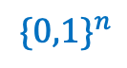
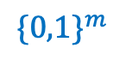

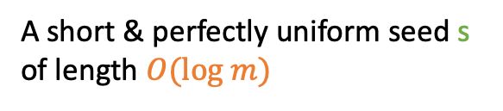
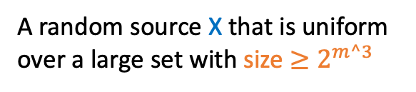
Recap: Trevisan’s Extractor
$$\{0,1\}^{n}$$
$$\{0,1\}^{m}$$
X
Y = Ext(X, s)
Y
Y that is $δ$-close to uniform
Luca Trevisan
A random source X that is uniform
over a large set with size $≥2^{m^3}$
$$\{0,1\}^{log m}$$
s
A short & perfectly uniform seed s of length $O(log m)$

Slide 43
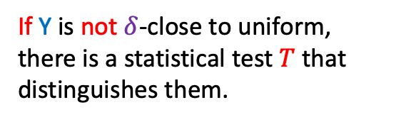

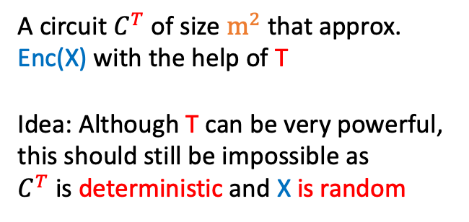
Recap: Trevisan’s Extractor
$$\{0,1\}^{n}$$
$$\{0,1\}^{m}$$
X
Y = Ext(X, s) = ${NW}^{Enc(X)}$
Y
$Enc$ is a
list-decodable code
If Y is not $δ$-close to uniform,
there is a statistical test $T$ that distinguishes them.
Luca Trevisan
A random source X that is uniform
over a large set with size $≥2^{m^3}$
Step1: Prove
$Pr[$fixed string can approx. Enc(X)]$≤2^{−m^{3}}$
A circuit $C^{T}$ of size $m^{2}$that approx. Enc(X) with the help of T
Idea: Although T can be very powerful,
this should still be impossible as
$C^{T}$ is deterministic and X is random
$NW$ reconstruction
Step2: Union bound over $2^{O(m^{2}log m)}$ many $C^{T}$.
Step3: Conclude that $T$ does not exist.

Slide 44


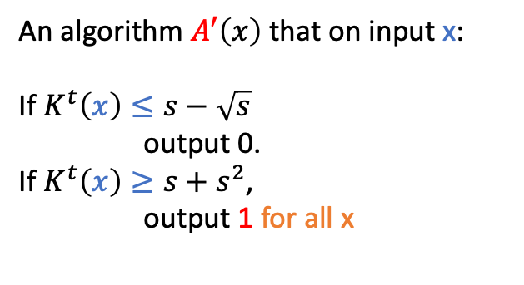
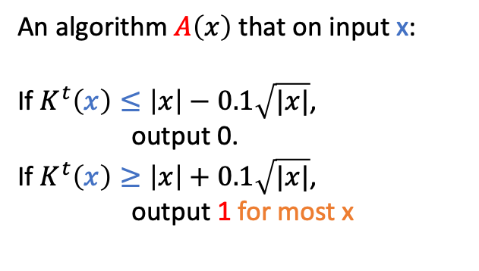
[Hirahara’18]
“Non-black-box Worst-case to Average-case Reductions within NP”
We want…
Some transformation
An algorithm $A\left(x\right)$ that on input x:
If $K^{t}\left(x\right)≤\left|x\right|−0.1\sqrt{|x|}$,
output 0.
If $K^{t}\left(x\right)≥\left|x\right|+0.1\sqrt{|x|}$,
output 1 for most x
An algorithm $A′\left(x\right)$ that on input x:
If $K^{t}\left(x\right)≤s−\sqrt{s}$
output 0.
If $K^{t}\left(x\right)≥s+s^{2}$,
output 1 for all x
Shuichi HIrahara
Average-case
Worst-case

Slide 45
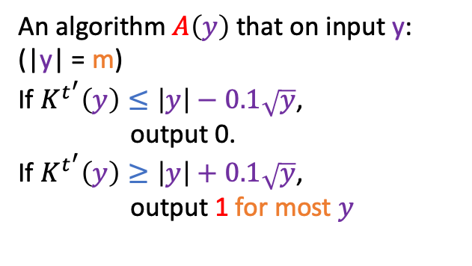
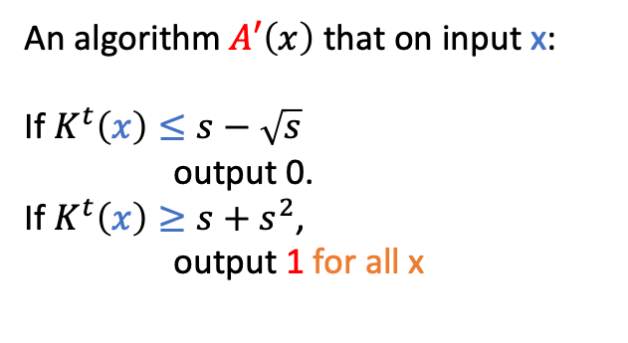
[Hirahara’18]
“Non-black-box Worst-case to Average-case Reductions within NP”
We want…
Some transformation
Reduction
An algorithm $A′\left(x\right)$ that on input x:
If $K^{t}\left(x\right)≤s−\sqrt{s}$
output 0.
If $K^{t}\left(x\right)≥s+s^{2}$,
output 1 for all x
An algorithm $A\left(y\right)$ that on input y:
(|y| = m)
If $K^{t^{′}}\left(y\right)≤\left|y\right|−0.1\sqrt{y}$,
output 0.
If $K^{t^{′}}\left(y\right)≥\left|y\right|+0.1\sqrt{y}$,
output 1 for most $y$
Shuichi HIrahara
Worst-case
Average-case

Slide 46

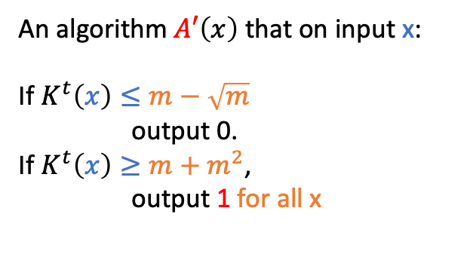
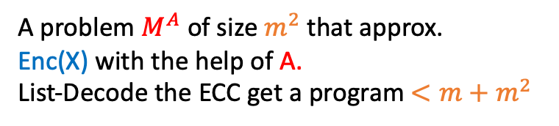
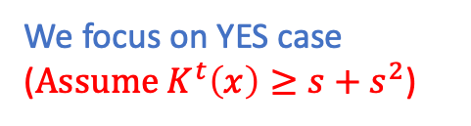
[Hirahara’18]
“Non-black-box Worst-case to Average-case Reductions within NP”
$$y={NW}^{Enc(x)}(s)$$
Reduction
An algorithm $A′\left(x\right)$ that on input x:
If $K^{t}\left(x\right)≤m−\sqrt{m}$
output 0.
If $K^{t}\left(x\right)≥m+m^{2}$,
output 1 for all x
An algorithm $A\left(y\right)$ that on input y:
(|y| = m)
If $K^{t^{′}}\left(y\right)≤\left|y\right|−0.1\sqrt{y}$,
output 0.
If $K^{t^{′}}\left(y\right)≥\left|y\right|+0.1\sqrt{y}$,
output 1 for most $y$
Shuichi HIrahara
Suppose it outputs NO
(for contradiction)
NO case is always correct
For random string it outputs YES
We focus on YES case ($Assume K^{t}\left(x\right)≥s+s^{2}$)
Worst-case
Distinguisher
A problem $M^{A}$ of size $m^{2}$ that approx.
Enc(X) with the help of A.
List-Decode the ECC get a program $<m+m^{2}$
$NW$ reconstruction

Slide 47
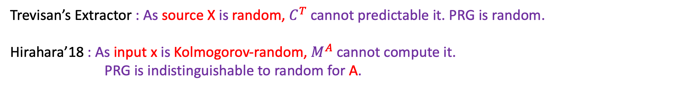
Reflection
Comparison with Trevisan’s Extractor:
Trevisan’s Extractor : As source X is random, $C^{T}$ cannot predictable it. PRG is random.
Hirahara’18 : As input x is Kolmogorov-random, $M^{A}$ cannot compute it.
PRG is indistinguishable to random for A.
The power of using pseudorandomness
Natural way of doing reduction: Use true randomness to send x ->y.
Issue: Since y is random, it has high complexity no matter what x is.
Hirahara’18 : Use computational pseudo-randomness that was extracted from x itself.
Benefit: When x is high-complexity, y is random.
When x is low-complexity, y is also low-complexity.

Slide 48

Thanks.
Cryptomania:
$∃$ Public-key crypto
Mini-crypt:
$∃$ Secret-key crypto
Pessiland:
DistNP $≠$ AvgP but no crypto
Heuristica:
P $≠$ NP but DistNP = AvgP
Algorithmica:
P = NP
[Liu-Pass’ 20]
Two-sided Avg-Case Hardness
Errorless Avg-Case Hardness
If time allows,
I’ll say a little about these.
[Hirahara’ 18]
MCSP*
Worst case hardness of approximate MINKT
[Hirahara’ 22]

